Slide 1

TAXI INDUSTRY REVIEW How to win the competiton
Prepared for :
ABC Taxi
By : Rico Martin Sitorus

Slide 2
Today’s Agenda
Customer Statisfaction Review
How to improve more customer statisfaction
Priorities for execution
Summary and recommendations

Slide 3
CUSTOMER STATISFACTION REVIEW.
DO THE CUSTOMER STATISFIED WITH THE CURRENT TAXI INDUSTRY ?

Slide 4
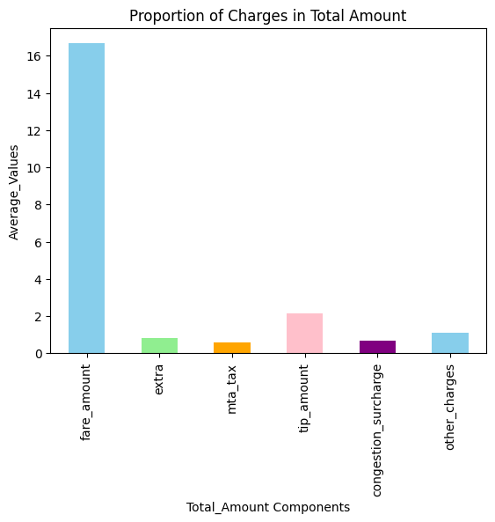
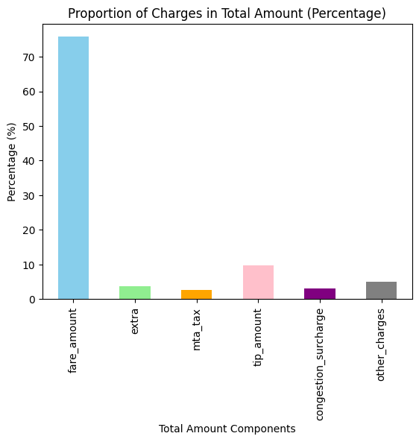
From the chart, we can observe that congestion_surcharge and tip_amount contribute quite significant to taxi industry income, with average percentange within 20%

Slide 5
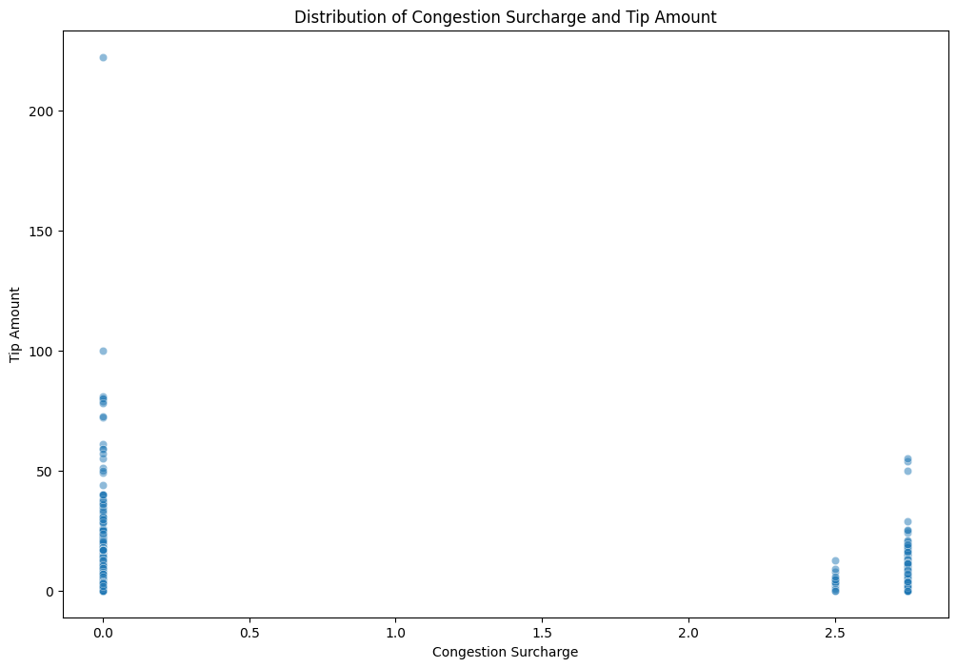
Checking the statisfaction using the tip vs congestion_surcharge using spearmen since the data not normally distributed
The Spearman’s results show strong correlation between tip and congestion surcharge, although with positive direction
Need futher check, as this result contrary to the first hypothesis where people tend to distatisfied when stuck in traffic
Spearman's Results (Congestion Surcharge vs Tip Frequency)
Correlation | 0.231
P-Value | 0.000

Slide 6
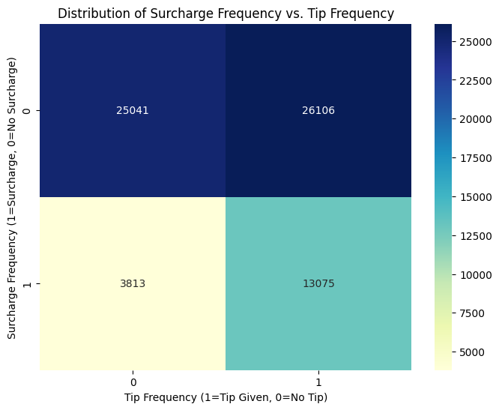
In more granular view we can obtain that there’s indication that people will disstatisfied when stuck in traffic
As the number of people who give tip when there’s no congestion surcharge (due to traffic jam) is significantly higher compared to other condition
We can ingnore this quadrant, since this quadrant denotes the people who don’t give tip eventhough they don’t trap in traffic
People will be more likely to give tip when they don’t stuck at the traffic jam

Slide 7
HOW TO IMPROVE MORE PASSENGER STATISFACTION ?

Slide 8
Provide more time-saving payment method for easy and quick payment

Slide 9
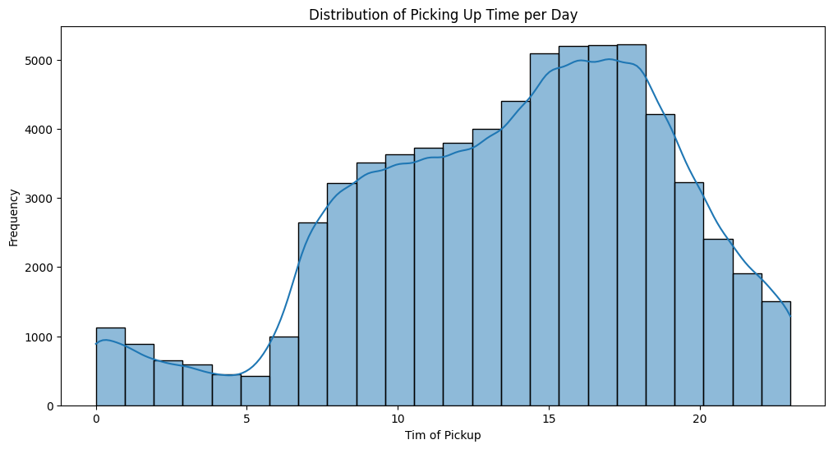
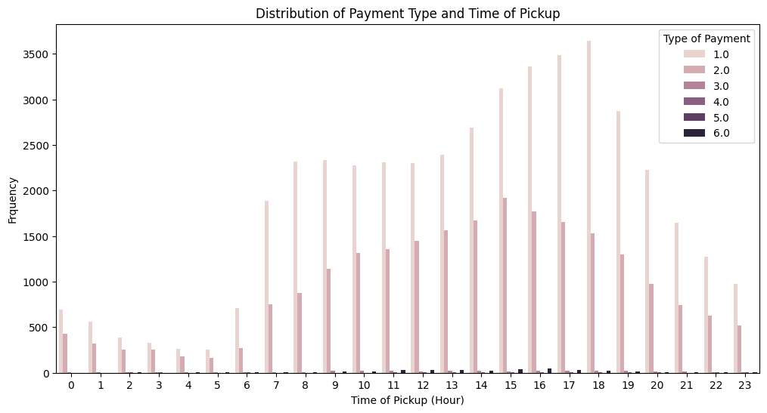
Increase the number of Credit-Card Payment System in our vehicles and sought to see more pratice payment system
As credit card usage shows significant increase during rush hour, indicating people want the practice / time – saving method
Type of Payment :
1 = Credit Card
2= Cash
3 = No Charge
4 = Dispute
5 = Unknown
6 = Canceled

Slide 10
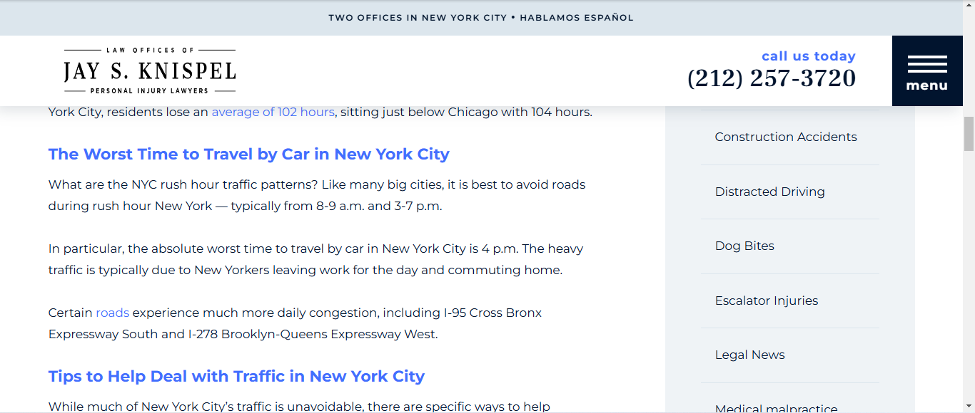
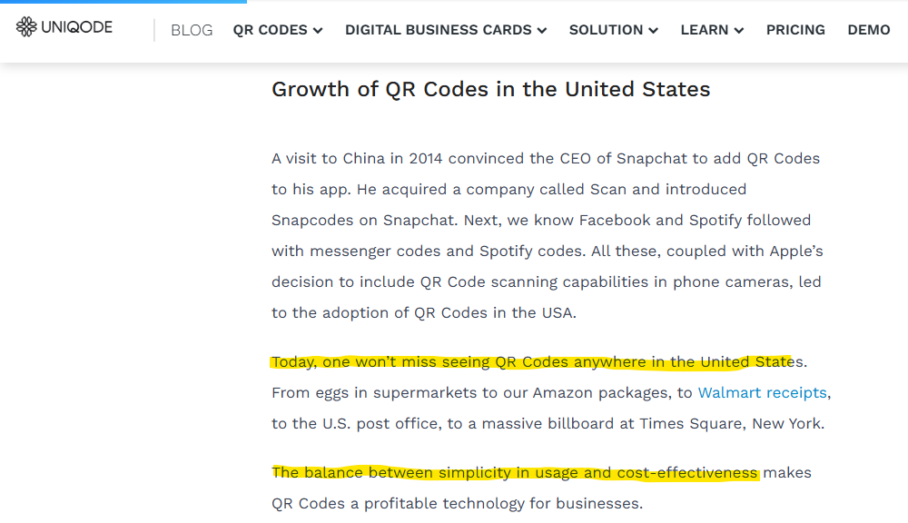
Despite of Credit-Card, consider to use QR Code for alternative payment for people who don’t have credit card
To help providing fast payment system especially to cater the needs during rush hour in NYC
https://jknylaw.com/blog/worst-traffic-times-in-new-york-city/
https://www.uniqode.com/blog/qr-code-insights/qr-code-usage-united-states/

Slide 11
Route Effectiveness
&
Passenger Engagement

Slide 12
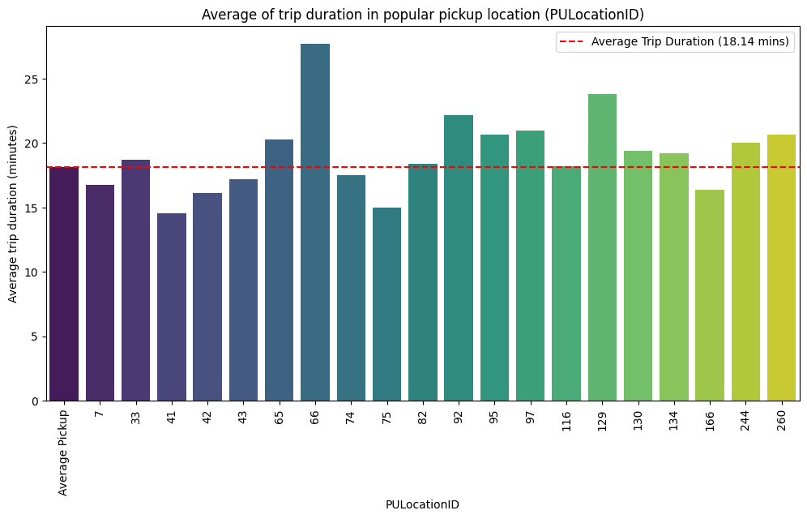
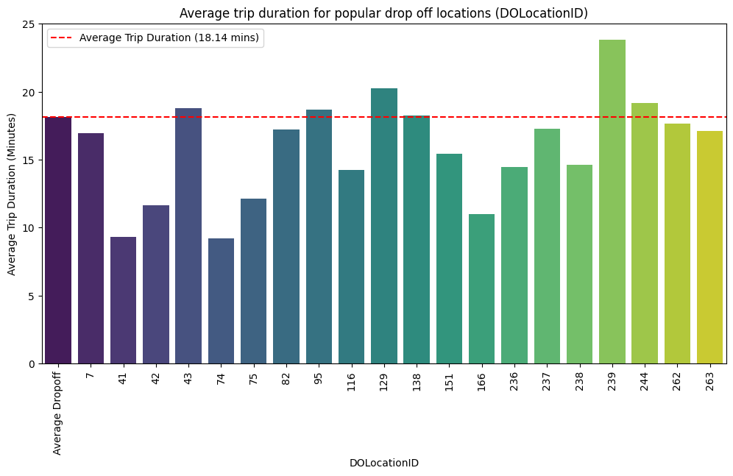
Avoid driving through several heavy traffic location during rush hour if avoidable
Provide treats or price cut for the passengers that picked, dropped or through the heavy traffic areas.
Avoidable
Not Avoidable
Provide treads, like snacks, to boost passenger’s mood
OR
Price cut for customers that must drive through the heavy traffic
Prevent routing through these ID Locations :
43, 65, 66, 92, 97, 129, 130, 134, 239, 244 and 260
During rush hour to save passenger’s time

Slide 13
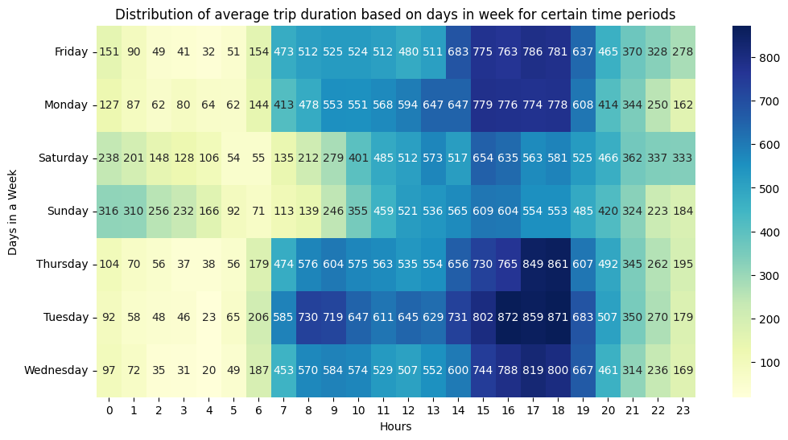
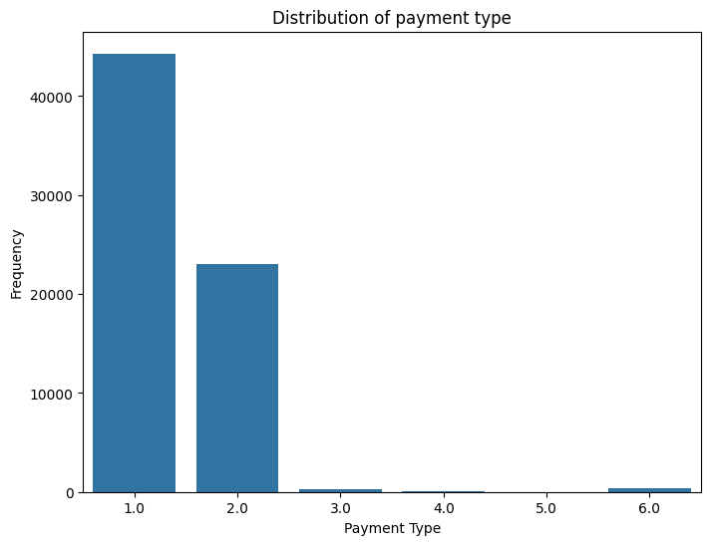
Consider the 16 - 18 USD as the threshold minimum fare before applying the price cut during rush hour for certain regions
This can help to promote statisfactions for passengers while also keeping the economic pressure for company
Average Paymet for each payment type
Type | Avg Fare (USD)
1 | 17.1
2 | 15.9
3 | 8.1
4 | 7.1
5 | 14
6 | 13
Type of Payment :
1 = Credit Card
2= Cash
3 = No Charge
4 = Dispute
5 = Unknown
6 = Canceled

Slide 14
Special Price or Promotion
For Airport Transport

Slide 15
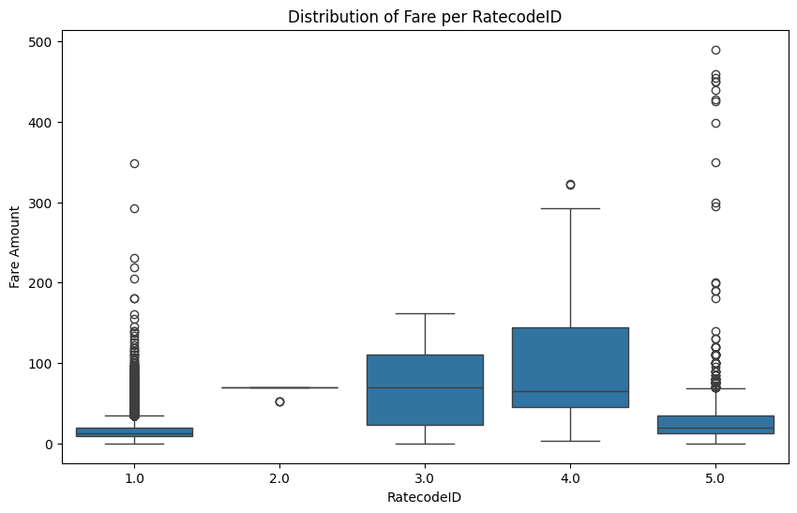
Consider the special price or price discount for passengers commute to the airport
As the distance and price usually higher compared to standard or negotiated ones. The initiative may promote more customer statisfaction
Type of RatecodeID :
1 = Standard
2= JFK
3 = Newark
4 = Nassasu or Westchester
5 = Negotiated

Slide 16
Conclusions and Recomendations
Situation | Call-to-Action:
ABC Taxi want to understand the current performance of the taxi industry. The information will be useful for them to win the provider competition | Utilize the Credit Card (CC) and currently emerging QR Code payment to promote fast and easy payment method that cater both people with CC and without CC Avoid driving through certain the areas 43, 65, 66, 92, 97, 129, 130, 134, 239, 244 and 260 during rush hour, and improve our fleets during this period Provide treats or price cut for passengers that must travel to or through area 43, 65, 66, 92, 97, 129, 130, 134, 239, 244 and 260 The discount threshold is when minimum fare around 16 – 18 USD Consider to provide special price or discount for long-range commuting, like to airport
Complication | Answer
In general, the passengers’ statisfactions in taxi industry impacted by the inevitable traffic jam. | Focus on recovering Colgate’s share loss from Uber Premium, Upper Value & Mid Priced, while maintaining our strong momentum in Super Premium. Recovering Losses: Consider price promotion for our Upper Value 1X1 which is threatened by Berman’s growth in distribution. Focus on driving distribution for Colgate Gum Clean & Extra Clean Soft 1x1 due to the growing competitiveness of Berman Active Anti Bacterial 1x1 Opportunity for further growth: In Super Premium, drive demand for Ultra Soft x1.
Question
What can we do to improve passenger’s statisfactions. That may help to win our passenger’s heart and maintain users penetration and retention.

